Slide 1
Innovations in Pro Bono TIG Conference 2013
OnlineTNJustice.org: Free Legal Advice and Counsel for Low-income Tennesseans
Erik Cole, Executive Director, TALS
ecole@tals.org/615.627.0956

Slide 2
Online Tennessee Justice
Utilizing Technology to Expand Pro Bono Opportunities
Tennessee’s access to justice leadership recognized an unmet need to serve citizens who might otherwise fall through the cracks of receiving legal assistance.
This problem is particularly acute in rural areas – or legal deserts – where there are more barriers to attorneys providing pro bono services
In 2010, the Tennessee Bar Association, TALS, and the law firm of Baker Donelson Berkowitz Bearman and Caldwell collaborated to design an online statewide legal clinic
The Tennessee Supreme Court Access to Justice Commission included the establishment of such a system in its inaugural Strategic Plan
Baker Donelson IT staff volunteered to secure the appropriate system. They successfully solicited donations from Microsoft and Dell for software and hardware.

Slide 3
Online Tennessee Justice
OnlineTNJustice.org is based on the walk-in clinic or dial-a-lawyer model where clients request brief advice and counsel about a specific civil legal issue from a volunteer lawyer. Lawyers provide information and basic legal advice without any expectation of long-term representation.
Website where qualifying Tennesseans can ask a lawyer for help with a legal issue.
For low-income (<250% below Federal Poverty Guidelines) Tennesseans, who are not incarcerated, and have <$5,000 total assets
Qualifying users can post questions on the website about their civil legal needs and receive basic legal information and advice from approved volunteer attorneys.

Slide 4
Goals and Approach
The website was created in order to eliminate barriers to lawyer pro bono (such as geographic location, work schedule or family obligations), expand pro bono to the most rural areas of Tennessee and provide assistance to eligible Legal Aid clients who are turned away due to lack of resources.
Goals
to enhance access to justice for low income and rural Tennesseans.
to serve clients who may not be served by traditional legal aid services
to remove barriers to providing pro bono services for attorneys.
Approach
Clients
Free
Easy-to-use
Can access at any time of day from anywhere with internet access
Anonymous
Volunteer Attorneys
Provide pro bono any time of day from anywhere with web access
Requires minimal commitment to clients
Receive CLE credit for service

Slide 5
OnlineTNJustice.org Data
Volunteer Attorneys
342 volunteer attorneys are registered
171 attorneys have answered questions
7 attorneys have answered more than 50 questions
28 attorneys have answered more than 20 questions
Clients
2695 questions posted as of December 12, 2012
2895 people have been determined eligible to use the site.
Questions by Category
Questions are posted in one of 11 areas of substantive law
Top categories thus far:
Family Law Matters (1249)
Other (495)
Housing (320)
Debt and Purchases (234)
Work (140)
Most answered within 48 hours, though attorneys have up to three days to respond.

Slide 6
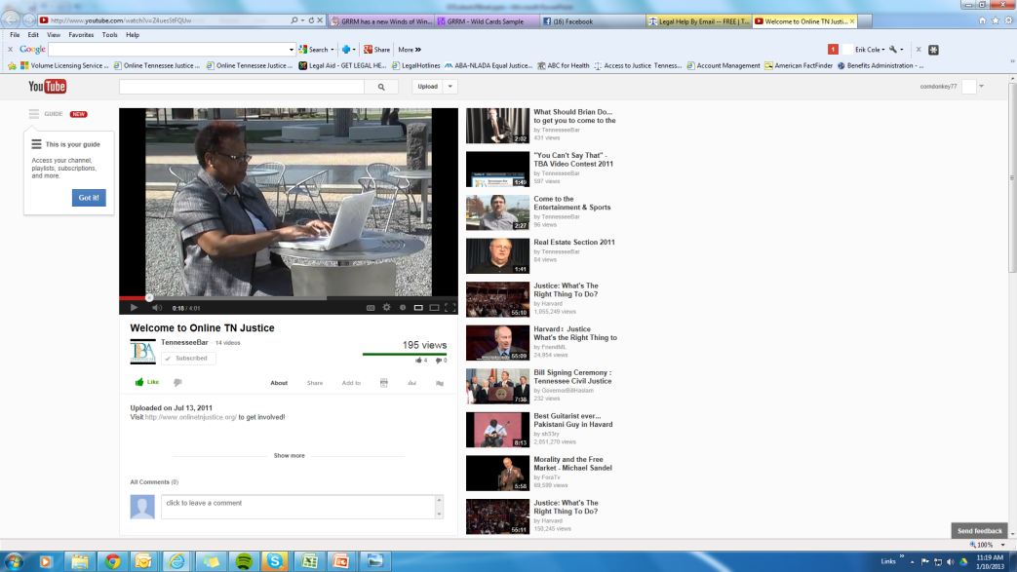
Training Pro Bono Lawyers
TN Bar Association responsible for recruiting attorneys
TALS/TBA collaborate on marketing and promotion
TBA trains attorneys for using the site (youtube video how-to)
TALS maintains site and responds to issues from clients and pro bono attorneys
Steering committee of TBA/TALS/ATJ Commission make programmatic decisions
TALS manages and submits all CLE reporting for volunteer attorneys

Slide 7
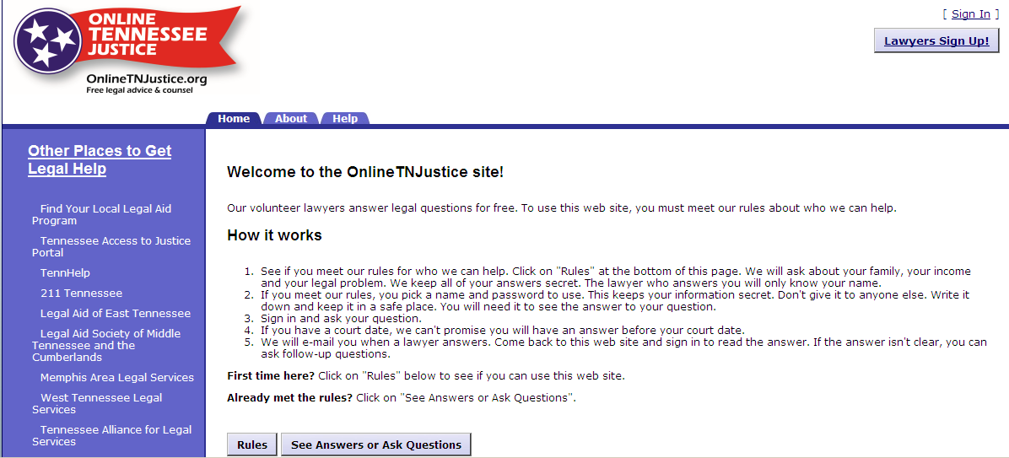
How it Works: The Day to Day
Clients and attorneys login to use the site at any time of day from any computer with Internet access and either ask or answer a question through the anonymous email platform. Emails notify clients and attorneys when they receive responses or follow-up questions.

Slide 8
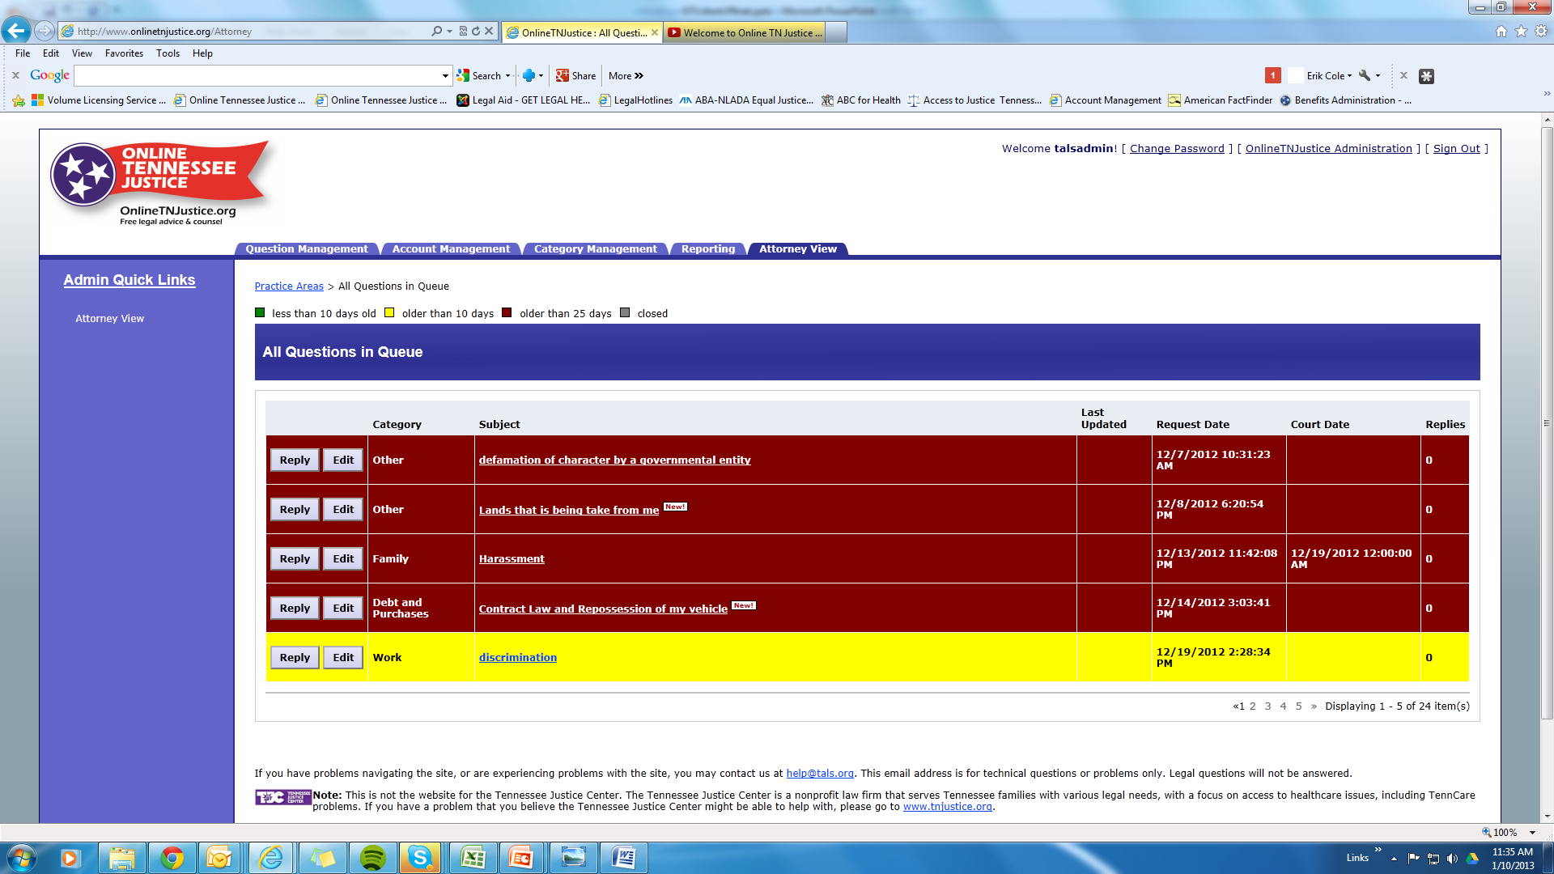
How it Works: The Day to Day

Slide 9
Tracking and Reporting

Slide 10
Promotion and Outreach

Slide 11
Next Steps
Outreach
Producing new outreach materials that will combine OTJ, the new 1-888-aLEGALz help line, and other resources into a simple “leave behind” or handout document
Conducting more in-depth outreach to referral sources. Describing sites and expectations to intake staff and receptionists at each legal aid program.
Continuing to distribute current materials in quantity to clerks, providers, and other social service providers.
Updates
Spanish version in development
Using Google Translate on our platform we should be able to expand to other languages down the road.
Site improvements have been implemented (users can update their own passwords, new responses are flagged, and screen to screen navigation improved).
TALS and TBA have demonstrated site to over 12 other states. Two states – Indiana and South Carolina are actively working to launch their own versions.

Slide 12
Interested?
The OTJ platform is available for adoption by other states. Baker Donelson IT staff are currently working with two states to adapt the system to their needs.
Baker Donelson will enter into license the system free of charge to additional states
Major cost is in hardware and technical set-up and ongoing support.
Interested? Contact Liz Todaro at the TN Bar Assocation - ltodaro@tnbar.org or (615) 383-7421

